Slide 1


Characterizing Knowledge Graphs in the Embedding Space
Faculty of Information Engineering, Informatics and Statistics
M.Sc. in Engineering in Computer Science
Candidate
Francesco Ottaviani
1759720
Advisor
Prof. Aris Anagnostopoulos
Co-Advisors
Ilaria Bordino
Francesco Gullo
Davide Mottin

Slide 2
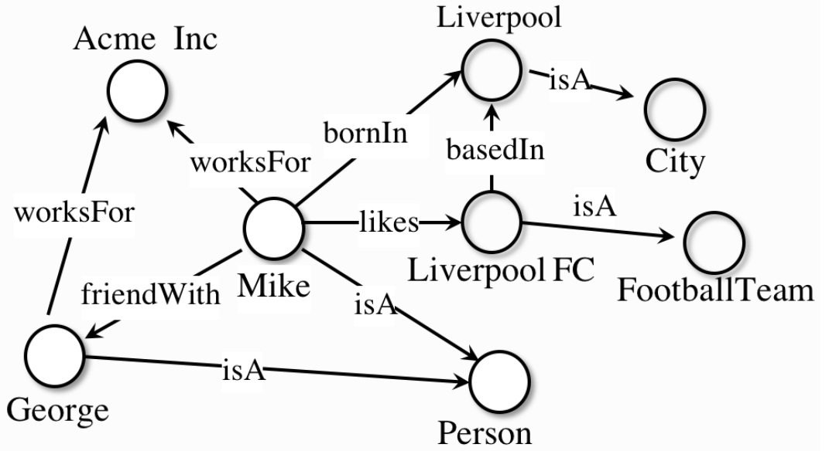
Knowledge Graphs
A knowledge graph (KG) represents a network of real-world entities (i.e., objects, events, situations, or concepts) and illustrates the relationship between them.
More formally, given a set of entities E, and a set of relations R, a knowledge graph is a subset of the cross-product E×R×E. Each member of this set is referred to as a triple.
Triples are defined as (h, r, t), which represents the existence of a relation r between the head entity h and the tail entity t.
Characterizing Knowledge Graphs in the Embedding Space
14/01/2022
Slide <number>

Slide 3
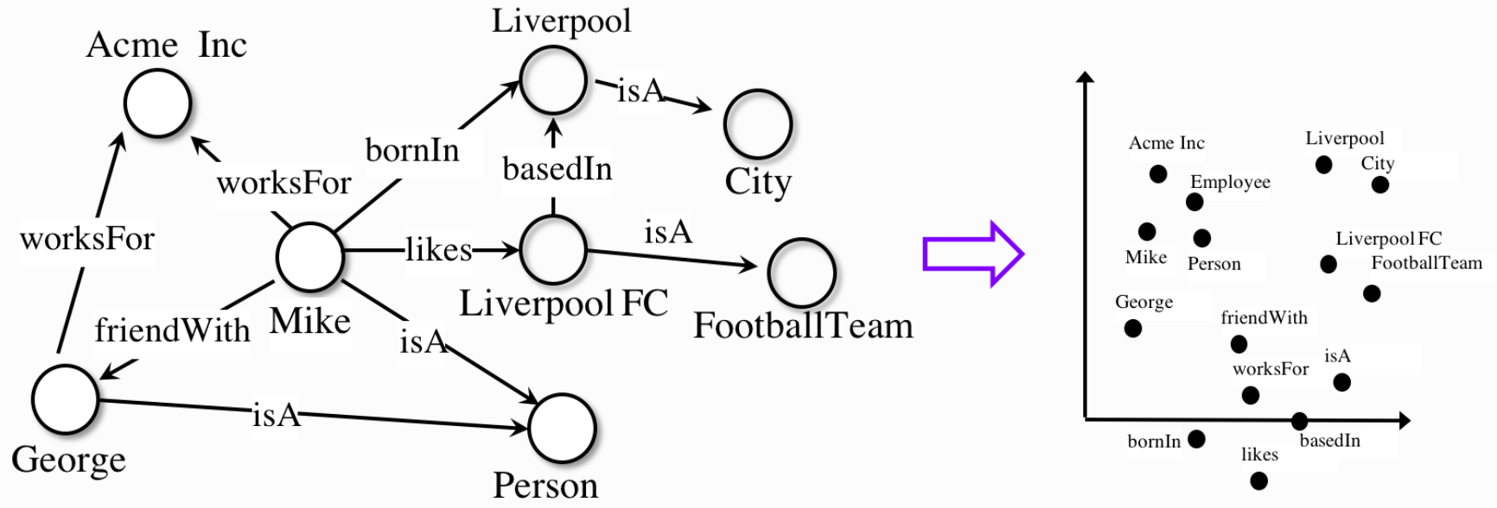
Knowledge Graph Embeddings
Knowledge graph embedding (KGE) aims to represent a graph as low-dimensional vectors while the graph structures are preserved.
Characterizing Knowledge Graphs in the Embedding Space
14/01/2022
Slide <number>

Slide 4
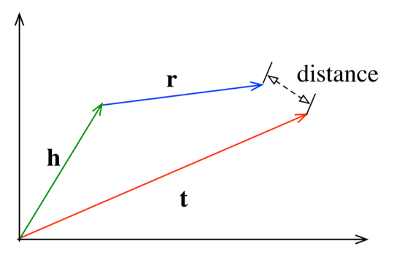

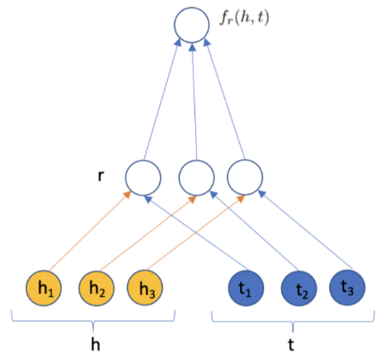

Main KGE models
TransE [Bordes et al. 2013]
  Scoring function
DistMult [Yang et al. 2015]
  Scoring function
Where e_{h},e_{r},e_{t} are the embeddings of head, relation and tail.
Characterizing Knowledge Graphs in the Embedding Space
14/01/2022
Slide <number>

Slide 5
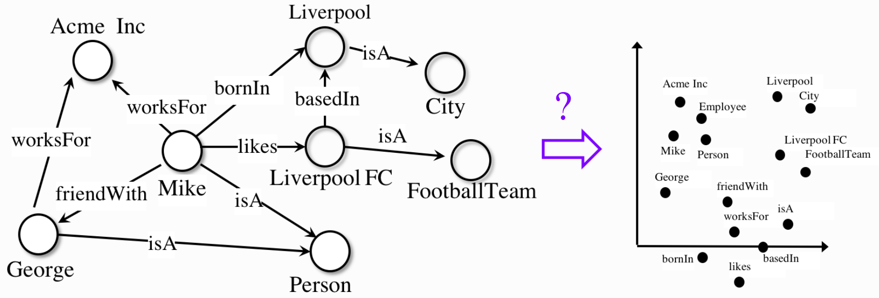
The problem
Characterizing Knowledge Graphs in the Embedding Space
14/01/2022
Slide <number>

Slide 6
A possible solution: reliability
The goal of the thesis project is to investigate the reliability of knowledge graph embeddings.
The need is to find the areas of the KG in which those models evaluate triples in the best way, then to perform experiments in order to understand the meaningfulness of the reliability measure.
It is necessary to use a Link Prediction strategy to compare the reliability of a subgraph with the accuracy of a classifier on the subgraph triples.
Assumptions made under the Closed World Assumption (CWA).
Characterizing Knowledge Graphs in the Embedding Space
14/01/2022
Slide <number>

Slide 7
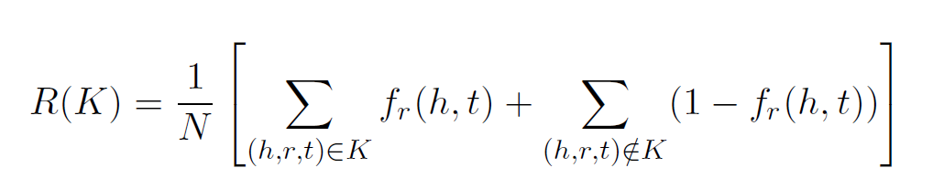
Reliability formula
R(K) is the reliability function.
K is a knowledge graph (provided as a set of triples).
N is the total number of triples (positives and negatives).
(h, r, t) represents a triple composed of head entity, relation, tail entity.
f_{r}(h,t) is the scoring function of the embedding model.
Characterizing Knowledge Graphs in the Embedding Space
14/01/2022
Slide <number>

Slide 8


Datasets
Knowledge Graph | # Entities | # Relations | # Triples
 | 14505 | 237 | 310079
 | 40943 | 18 | 151442
Characterizing Knowledge Graphs in the Embedding Space
14/01/2022
Slide <number>

Slide 9
Experimental phase (1/3)
Trained KGEMs on small and dense graphs.
Normalized scores with the min-max normalization for the reliability function.
Used the logistic regression model for the Link Prediction classifier.
Characterizing Knowledge Graphs in the Embedding Space
14/01/2022
Slide <number>

Slide 10
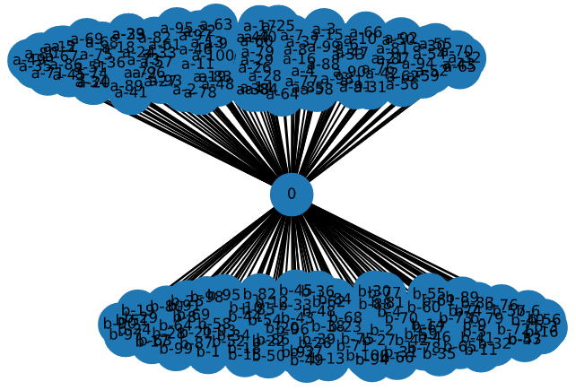
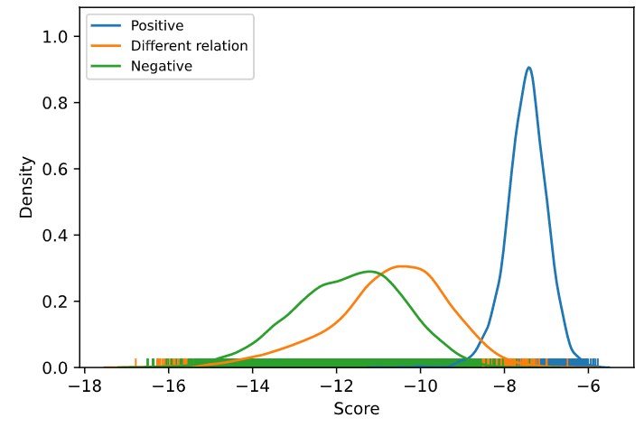
Experimental phase (2/3)
Experiment on a toy graph to verify how a model evaluate triples in a community.
Introduced a new set of triples (different relation) from a pair of neighboring entities.
Graph sampling with a depth-first search (DFS).
Removed outliers and normalized scores with a sigmoid function for the reliability task.
Characterizing Knowledge Graphs in the Embedding Space
14/01/2022
Slide <number>

Slide 11
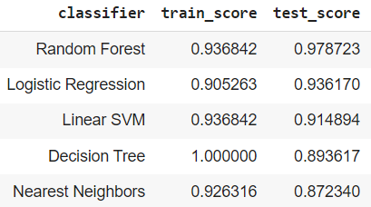
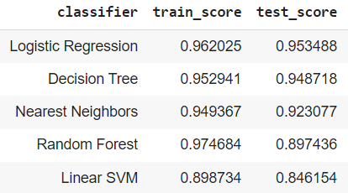
Experimental phase (3/3)
Different representation of the KG (directed or undirected).
Graph sampling with a breadth-first search (BFS).
Used entity and relation embeddings as feature vectors for the LP classifier, with others binary classification methods (SVM, Decision Trees, etc.).
Checked the correlation between reliability and accuracy values, through several metrics (Pearson, Spearman, Kendall-Tau).
LP task on Freebase
LP task on WordNet
Characterizing Knowledge Graphs in the Embedding Space
14/01/2022
Slide <number>

Slide 12
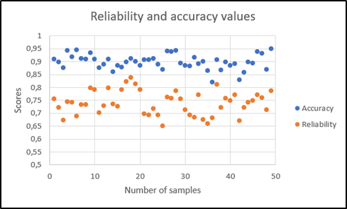
Results
Best option:
TransE on directed KGs, with a BFS to visit subgraphs and Logistic Regression as a method for the LP classifier.
Mean Scores (50 subgraphs)
# Nodes | Reliability | Accuracy
10 | 0,75 | 0,93
20 | 0,77 | 0,92
30 | 0,72 | 0,92
Pearson’s correlation: 0,85
Characterizing Knowledge Graphs in the Embedding Space
14/01/2022
Slide <number>

Slide 13
Conclusions and future plans
Introduce a measure of reliability for embedding
Found a good correlation between reliability and accuracy of the LP classifier.
Expand the evaluation to other embedding models.
Find new methods to visit subgraphs of a KG.
Consider more realistic assumptions such as Open World Assumption (OWA).
Characterizing Knowledge Graphs in the Embedding Space
14/01/2022
Slide <number>

Slide 14
Thank you!
Characterizing Knowledge Graphs in the Embedding Space
14/01/2022
Slide <number>

